Slide 1
Graphic Design 1
The “look & feel”

Slide 2
Agenda
Principles
Examples
SHW discuss
Poster discuss

Slide 3
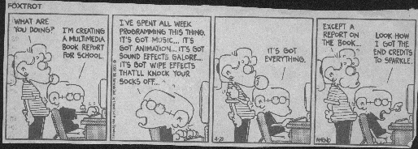
Who Needs Substance?

Slide 4
Graphic Design
The “look & feel” portion of an interface
Apa yang dilihat seseorang pertamakali?
  Conveys an impression, mood

Slide 5
Design Philosophies
My personal preferences:
  Economy of visual elements
  Less is more
  Clean, well organized
Imagery
Color
Sequencing
Layout
Typography
Organization

Slide 6
Graphic Design Principles
Metaphor
Clarity
Consistency
Alignment
Proximity (kedekatan objek)
Contrast

Slide 7
Metaphor
Tying presentation and visual elements to some familiar relevant items
  e.g., Desktop metaphor
  If you’re building an interface for a grocery application, maybe mimic a person walking through a store with a cart

Slide 8
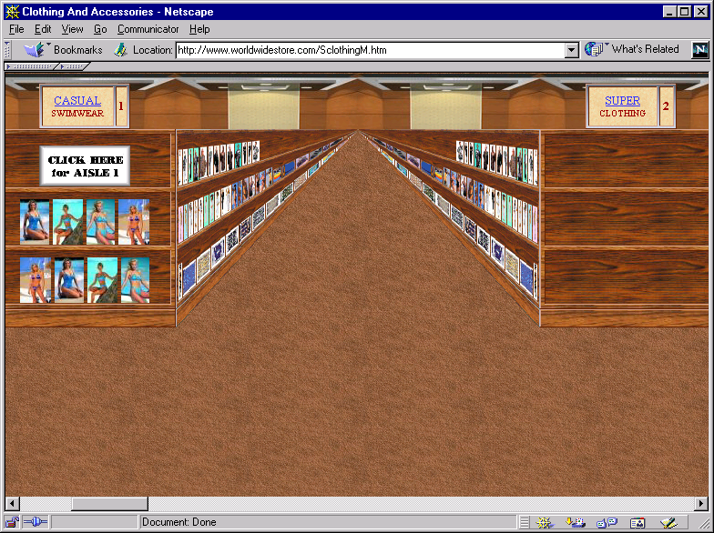
Example
Overdone?
www.worldwidestore.com/Mainlvl.htm

Slide 9
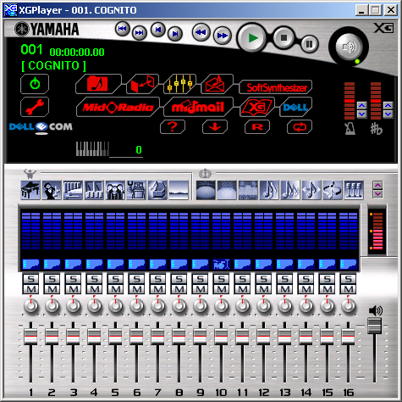
Clarity
Every element in an interface should have a reason for being there
  Make that reason
  clear too!
Less is more

Slide 10
Clarity
White space
  Leads the eye
  Provides symmetry and balance through its use
  Strengthens impact of message
  Allows eye to rest between elements of activity
  Used to promote simplicity, elegance, class, refinement

Slide 11
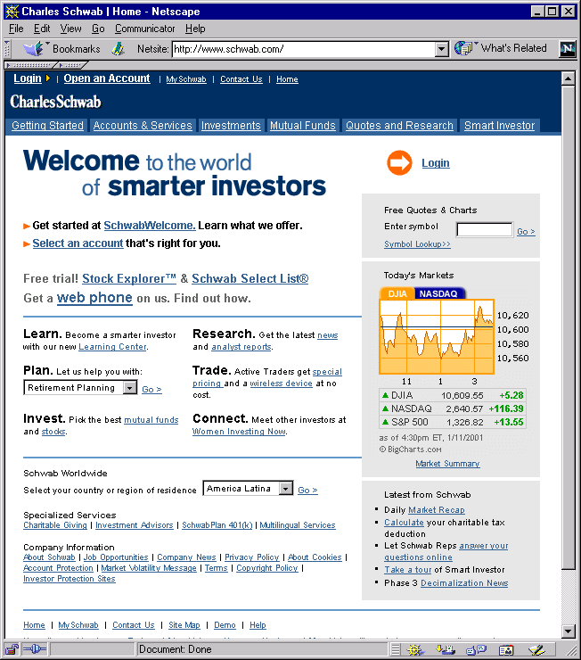
Example
Clear, clean
appearance
www.schwab.com

Slide 12
Consistency
In layout, color, images, icons, typography, text, …
Within screen, across screens
Stay within metaphor everywhere
Platform may have a style guide
  Follow it!

Slide 13
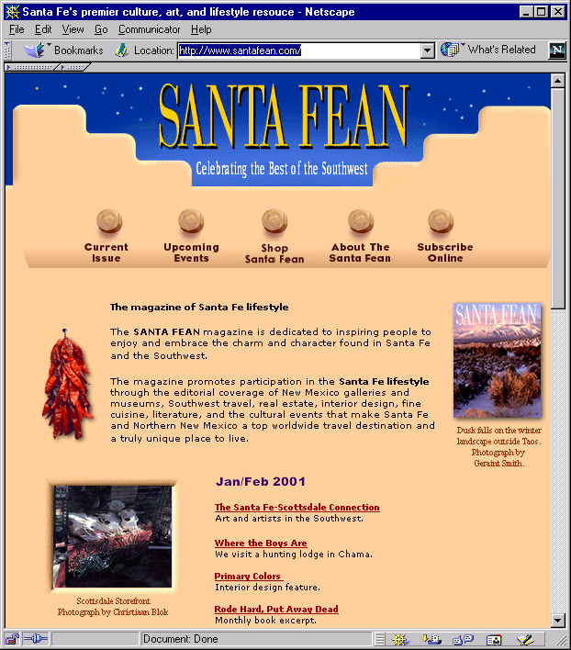
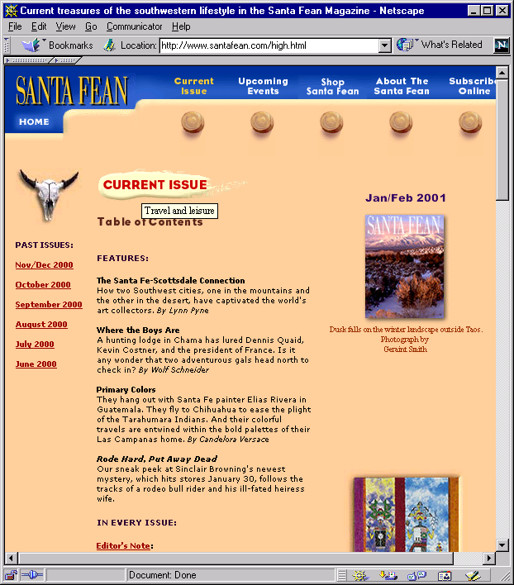
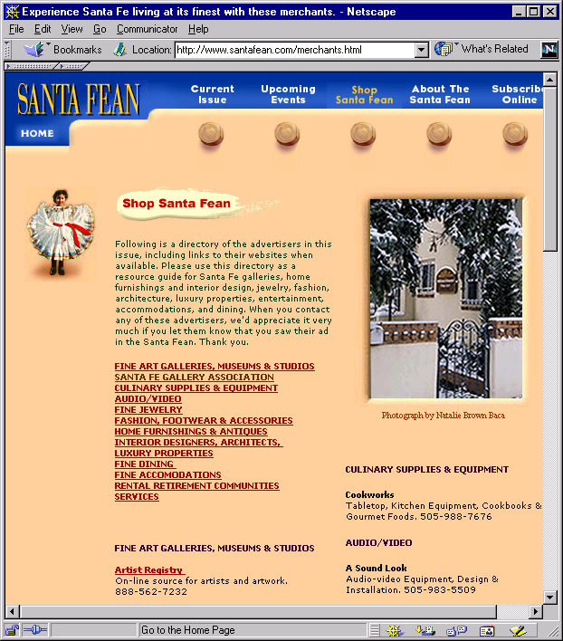
Example
Home page
Content page 1
Content page 2
www.santafean.com

Slide 14
Alignment
Western world
  Start from top left
Allows eye to parse display more easily

Slide 15
Alignment
Grids
  (Hidden) horizontal and vertical lines to help locate window components
  Align related things
  Group items logically
  Minimize number of controls, reduce clutter

Slide 16
Alignment
Grids - use them

Slide 17
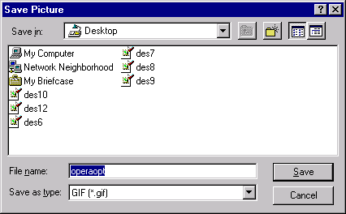
Grid Example

Slide 18
Alignment
Left, center, or right
Choose one, use it everywhere
Novices often center things
  No definition, calm, very formal
Here is
some
new text
Here is
some
new text
Here is
some
new text

Slide 19
Proximity (kedekatan)
Items close together appear to have a relationship
Distance implies no relationship
Time

Slide 20
Example
Name
Name
Name
Addr1
Addr1
Addr1
Addr2
Addr2
Addr2
City
City
City
State
State
State
Phone
Phone
Phone
Fax
Fax
Fax

Slide 21
Contrast
Menarik untuk dilihat
Guides your eyes around the interface
Supports skimming
Take advantage of contrast to add focus or to energize an interface
Dapat digunakan untuk membedakan tombol yang aktif

Slide 22
Contrast
Can be used to set off most important item
  Allow it to dominate
Ask yourself what is the most important item in the interface, highlight it
Use geometry to help sequencing

Slide 23
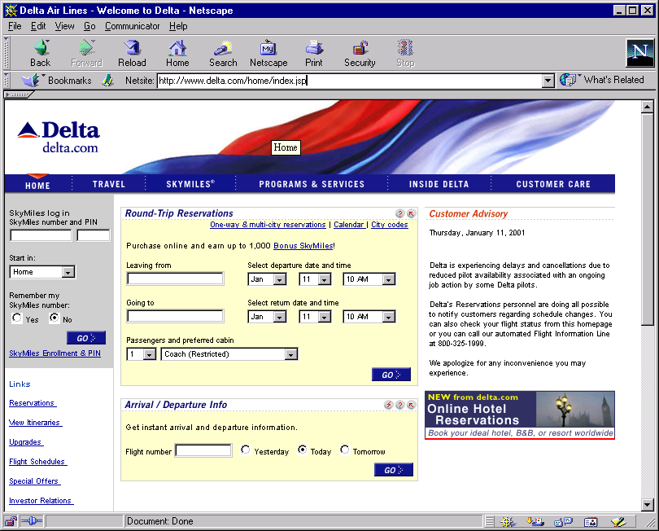
Example
Important
element
www.delta.com

Slide 24
UI Exercise
Look at interface and see where your eye is initially drawn (what dominates?)
Is that the most important thing in the interface?
Sometimes this can (mistakenly) even be white space!

Slide 25
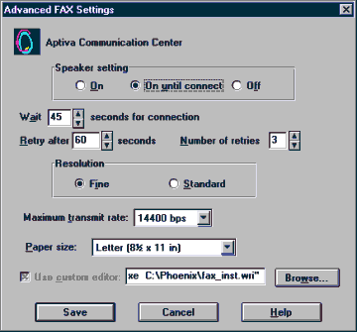
Example
Disorganized

Slide 26
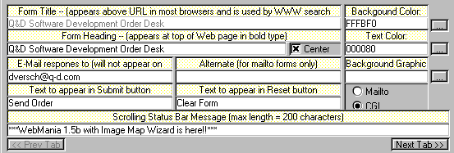
Example
Visual noise

Slide 27
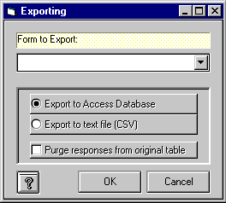
Example
Overuse of
3D effects

Slide 28
Economy of Visual Elements
Less is more
Minimize borders and heavy outlining, section boundaries (use whitespace)
Reduce clutter
Minimize the number of controls

Slide 29
Coding Techniques
Blinking
  Good for grabbing attention, but use very sparingly
Reverse video, bold
  Good for making something stand out
  Again, use sparingly

Slide 30
SHW - Design
Reactions to your designs
Designing for users?
One possible design

Slide 31
Poster Session Review
Logistics (my fault)
Very uneven presentations
Expected to see on every poster
  Project description, Users, Environment, Tasks, Implications, Usability criteria, etc.

Slide 32
Upcoming
More graphic design
Prototyping
Exam!

